Slide 1
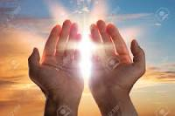
Intercessory Prayer

Slide 2

Fe
Featuring Shiloh Praise Ministry2022
Celebrating The Gift of A New Year

Slide 3
Every Sunday – 8:20 – 8:45 am
Corporate Praise & Petition Through Personal
Consecration and Prayer
“Let There be Silence in the Sanctuary so that we may hear the voice of God as He speaks to us in answer to our personal and collective prayers, petition and praise”
If YOU must speak, other than crying out to God,
PLEASE STEP OUTSIDE OF THE SANCTUARY

Slide 4
Shiloh Sunday Worship Schedule
Through December 31, 2024
  8:00 – 8:25 – Continental Breakfast
  8:20 – 8:45 - Prayer and Meditation
    Sanctuary All Quiet Before the LORD
  9:00 – 10:15 - Morning Worship
    Special Announcements
    Praise & Worship
    Ministry of The Word of God
    Worship in Giving
  10:15 – 10:45 – Bible Discovery Classes
& Special Intercessory Prayer
  10:45 - Closing Prayer & Benediction

Slide 5
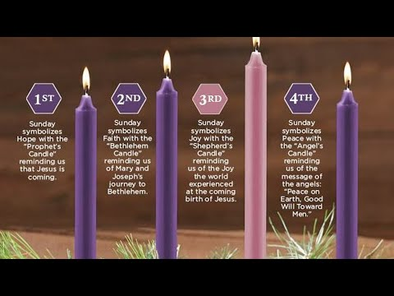
Meaning of the Advent Candles
PREPARED & PRESENTED BY SHILOH CHURCH BPT

Slide 6
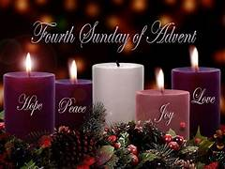

The 4th Candle of Advent 2024
The Angel’s Candle PEACE

Slide 7
Walking In Victory 2024-2025 – Step 1
December 1 – December 31
ACCEPTING AND TAKING RESPONSIBILITY FOR OURSELVES & OUR FAMILIES
  Monthly Shiloh Ministry Wide Training –
    Saturday, December 7- SHILOH RESET – CHURCH LEADERSHIP BREAKFAST 10AM til NOON
  BACK TO THE BASICS – Fasting 2 Days per Week/1 Week per Month/1 Month per Year
    Weekly – Fast & Pray on Tuesday and/or Saturday
      Vegetables & Juice/Water Only (Daniel Diet)
OR Juice/Water Only
    Daily - 1 EXTRA Hour of PERSONAL Prayer and/or Study
    Monday – Friday: “Your Daily Dose” Shiloh Facebook, Instagram & YouTube Channel – ALL ARE ONLINE AS Shilohchurchbpt
      8am – Inspiring Scripture Reading/12 Noon - 5 Minute Lesson/5pm Special Song
    BIBLE STUDY: ‘30 MinuteTuesdays’ – 12:15pm Live @ Shiloh - 477 Broad Street, Facebook & Instagram and 6:30pm on Facebook
    PRAYER: Monday – Friday 6:00-6:30am & 8:00 - 8:30pm Prayer Calls
      (605) 313-5088 Pin 1054312#
    Tuesday, December 31 – 10pm til Midnight WATCHNIGHT PRAYER & PRAISE

Slide 8
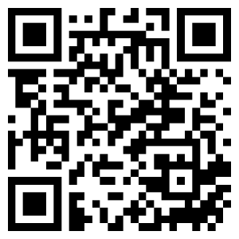
Right Now Media Launch: Click the link below to Register for your FREE Shiloh Church Account Today!
Invite link: https://app.rightnowmedia.org/join/shilohbaptistch

Slide 9
Fe
Featuring Shiloh Praise Ministry2022
Celebrating The Gift of A New Year

Slide 10
SHILOH CHURCH BPT’s SEASONS OF
“Growing through Walking TOGETHER in the Spirit”
”The Joy of Fulfillment”
It’s Time to Celebrate!!!
Scripture: Isaiah 12
Sr. Pastor/Teacher – Rev. Carl McCluster, MDIV
ADVENT SEASON SERIES 4 of 5
Sunday, December 22, 2024

Slide 11
Divine Destiny (God Already Knew)
Luke 2:1-4
In those days Caesar Augustus issued a decree that a census should be taken of the entire Roman world. ² (This was the first census that took place while^{[a]} Quirinius was governor of Syria.) ³ And everyone went to their own town to register.
⁴ So Joseph also went up from the town of Nazareth in Galilee to Judea, to Bethlehem the town of David, because he belonged to the house and line of David.
  A Change of Administrations
  Increasing Taxes
  Don’t Fear the Journey, Embrace It
  They Were Going with and Among Family

Slide 12
No One Left Behind
Luke 2:5-7
⁵ He went there to register with Mary, who was pledged to be married to him and was expecting a child. ⁶ While they were there, the time came for the baby to be born, ⁷ and she gave birth to her firstborn, a son. She wrapped him in cloths and placed him in a manger, because there was no guest room available for them.
- Who are the ‘left behind?’ (Children – Neighbors – Enemies)
- Who’s Gonna Tell Them? /Show Them / Help Them
- God Will Make a Way
- What You Gonna Do?

Slide 13
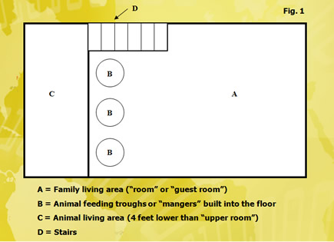
Floorplan for a Typical House in Bethlehem

Slide 14
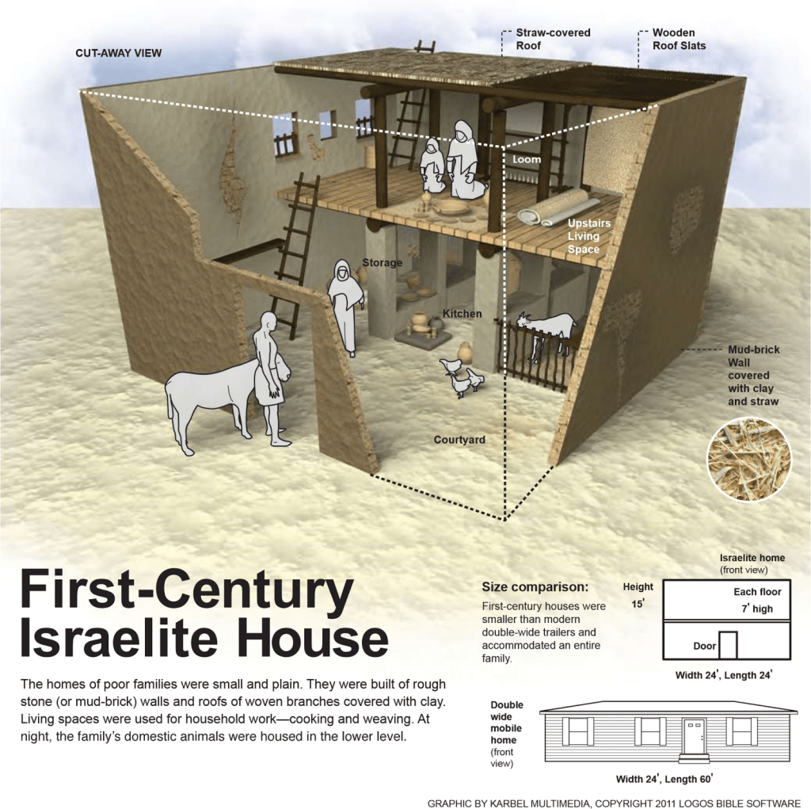

Slide 15
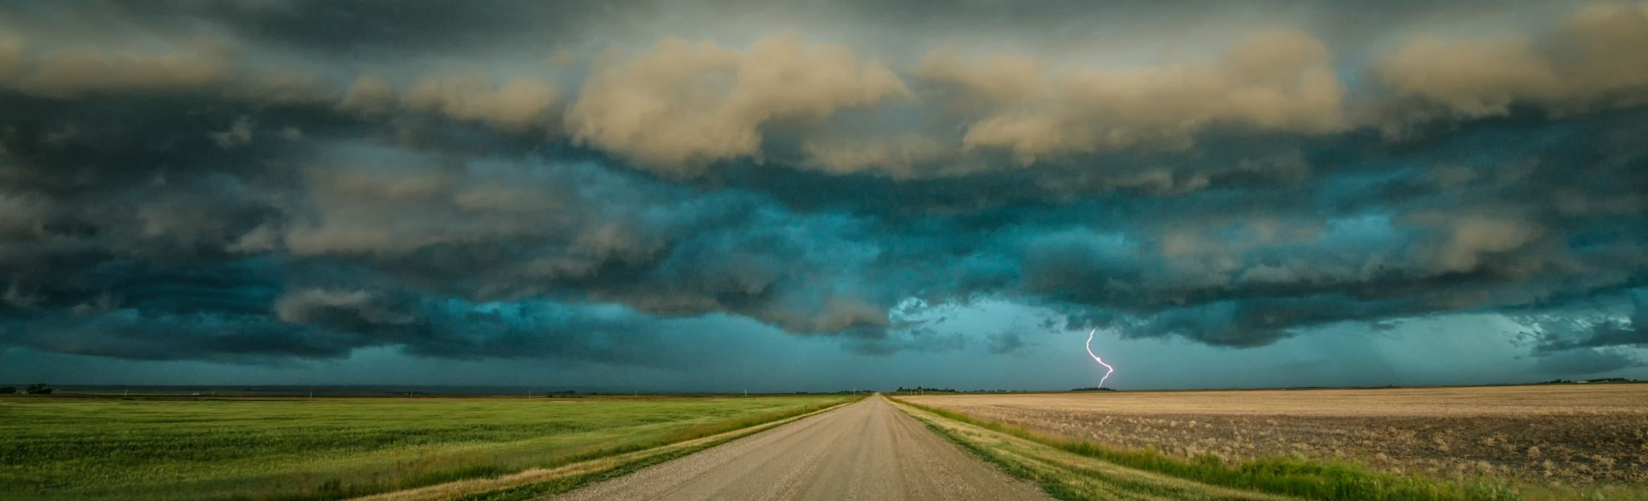
Don’t Miss YOUR Sign(s)
Luke 2:8-12
⁸ And there were shepherds living out in the fields nearby, keeping watch over their flocks at night. ⁹ An angel of the Lord appeared to them, and the glory of the Lord shone around them, and they were terrified. ¹⁰ But the angel said to them, “Do not be afraid. I bring you good news that will cause great joy for all the people. ¹¹ Today in the town of David a Savior has been born to you; he is the Messiah, the Lord. ¹² This will be a sign to you: You will find a baby wrapped in cloths and lying in a manger.”
- “We have nothing to fear, but fear itself” – Franklin Roosevelt
- “For God has not given us a spirit of fear, but of power, love and of a sound mind” 2 Timothy 1:7

Slide 16

The Presence of the Lord is Here
Luke 2:13-15
¹³ Suddenly a great company of the heavenly host appeared with the angel, praising God and saying,
¹⁴ “Glory to God in the highest heaven,
and on earth peace to those on whom his favor rests.”
¹⁵ When the angels had left them and gone into heaven, the shepherds said to one another, “Let’s go to Bethlehem and see this thing that has happened, which the Lord has told us about.”
- You’ve Got to See it for Yourself

Slide 17
You Don’t Know, Like I Know,
What the Lord has Done….
Luke 2:16-21
¹⁶ So they hurried off and found Mary and Joseph, and the baby, who was lying in the manger. ¹⁷ When they had seen him, they spread the word concerning what had been told them about this child, ¹⁸ and all who heard it were amazed at what the shepherds said to them. ¹⁹ But Mary treasured up all these things and pondered them in her heart. ²⁰ The shepherds returned, glorifying and praising God for all the things they had heard and seen, which were just as they had been told.
²¹ On the eighth day, when it was time to circumcise the child, he was named Jesus, the name the angel had given him before he was conceived.
- Only YOU can tell YOUR STORY
- Let Somebody Know….Through Your Praise

Slide 18
God Let’s You Make The Choice
What Will You Choose? Heaven or Hell
https://youtube.com/shorts/CHOuLLvnNGg?si=OMpLIhUTV2lXvZgq

Slide 19
You’ve Got to Choose for Yourself
Matthew 6:14-15
"For if you forgive other people when they sin against you, your heavenly Father will also forgive you. But if you do not forgive others their sins, your Father will not forgive your sins“
How Many Times Has God Forgiven You?

Slide 20
Never Forget God’s Promise
Psalm 34:7-10
⁷ The angel of the Lord encamps around those who fear him, and he delivers them.
⁸ Taste and see that the Lord is good;
blessed is the one who takes refuge in him.
⁹ Fear the Lord, you his holy people,
for those who fear him lack nothing.
¹⁰ The lions may grow weak and hungry,
but those who seek the Lord lack no good thing.

Slide 21
It’s time to make YOUR commitment;;
DECISION + commitment = BREAKTHROUGH
INDIVIDUALLY!!!
Give and Commit YOUR heart to God and receive salvation
COME TO THE ALTAR TRUSTING GOD FOR YOUR SALVATION AND RECEIVE HIS ANOINTING IN YOUR LIFE
Looking for a Real Relationship with God? –
INVITE GOD & Holy Spirit INTO YOUR HEART Through WORSHIP
SONG 1 My Worship - Phil Thompson (Lyrics)
SONG 2 - William McDowell - I Wanna Go Deeper live - YouTube

Slide 22
Invitation
“Give Your SELF to Christ”
PRAYER – PETITION - PRAISE
PRAY TO GOD FOR
SALVATION – FORGIVENESS – DELIVERANCE - POWER
PETITION GOD FOR
ANOINTING – STRENGTH – WISDOM – DIRECTION INSTRUCTION
PRAISE GOD FOR
HIS ANSWER - HIS MANIFESTATION - HIS ANOINTING
HIS BLESSING

Slide 23
Celebrate YOUR Breakthrough
CELEBRATING & AFFIRMING BREAKTHROUGH
INDIVIDUALLY & TOGETHER
COME TO THE ALTAR TRUSTING GOD FOR HIS ANOINTING IN YOUR LIFE
HE IS WALKING WITH YOU EVERY DAY!!
CONFESSING – BELIEVING- CONFESSING – TRUSTING – RECEIVING
Aware Worship - Trust In God (Featuring Mark Gutierrez) – YouTube

Slide 24
WORSHIP IN GIVING
Personal Commitment
  Tithes
  Offering
  Sacrificial
  Giving Song – Praise/Bless the Lord with Me
  https://www.youtube.com/watch?v=vBOa1SI8lZU&list=RDvBOa1SI8lZU&start_radio=1&ab_channel=MissYesenia

Slide 25


Welcome & Greeting
Visitors & Friends
WELCOME HOME TO SHILOH
“WHERE CHRIST IS LIFTED UP”

Slide 26
Closing Song of Celebration
“Standing”
https://www.youtube.com/watch?v=hNiKoJgvbtI&ab_channel=ajugofjoe

Slide 27
FELLOWSHIP
SHARE THE LOVE!!

Slide 29

Welcome to Faith Gospel Assembly

